Slide 1
Finding A Formula 2
Miss L
Year 7

Slide 2
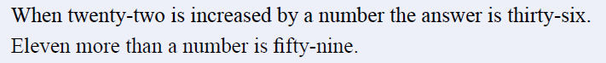
From Last Lesson

Slide 3
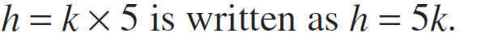
24
7
30
Algebra: Finding a Formula
DO NOT COPY DOWN
Date
EQ – How do you find a formula?
What is Algebra?
What is a Formula?
Algebra can be used to write a rule in a simple way
We can use a letter or symbol in place of a number
When a rule is written using a letter or symbol, its called a formula
A letter or symbol in a formula is called a variable because its value can change
When multiplying numbers and variables, we do not need to show the multiplication sign.
DO NOT COPY DOWN

Slide 4
Practice

Slide 5
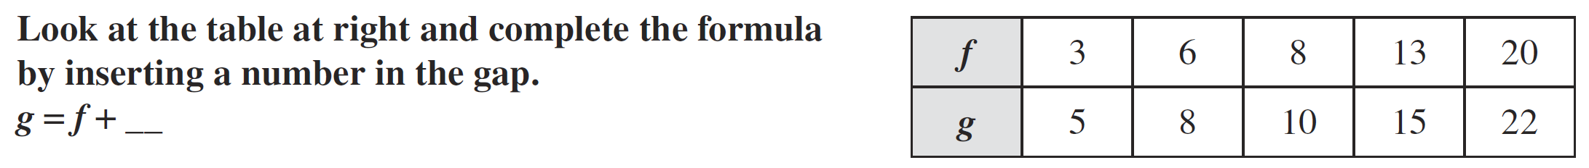
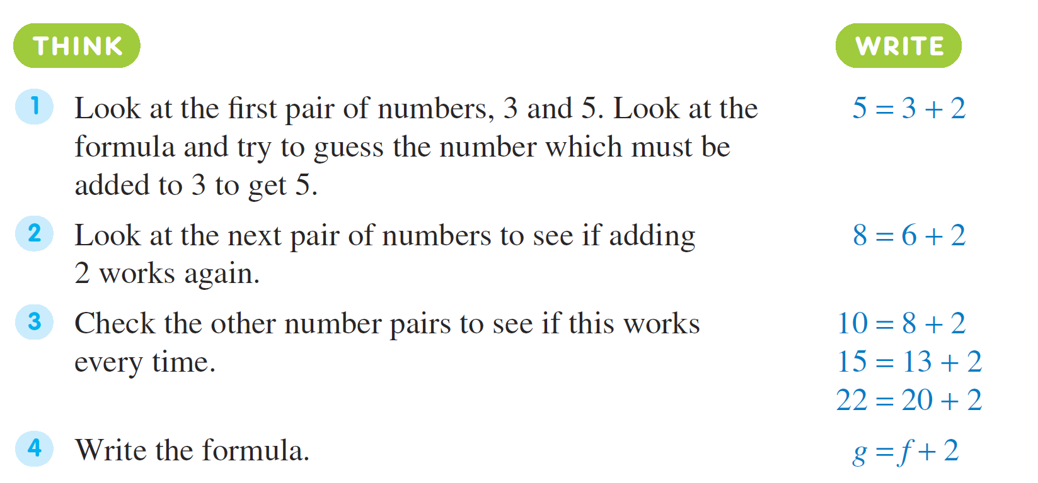
24
7
30
Finding a Formula 2
Date
EQ – How do you find a formula from a table?

Slide 6
24
7
30
Finding a Formula 2
Date
EQ – How do you find a formula from a table?

Slide 7


Slide 8
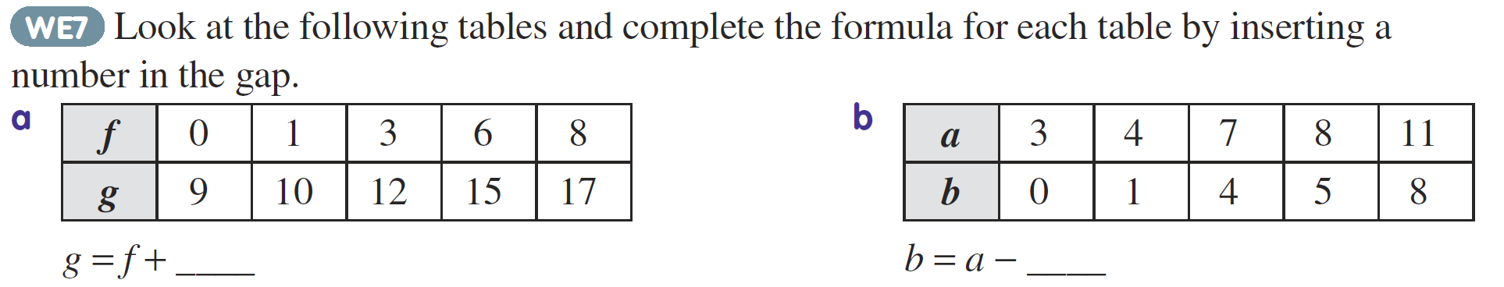
Practice

Slide 9
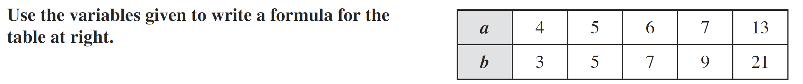
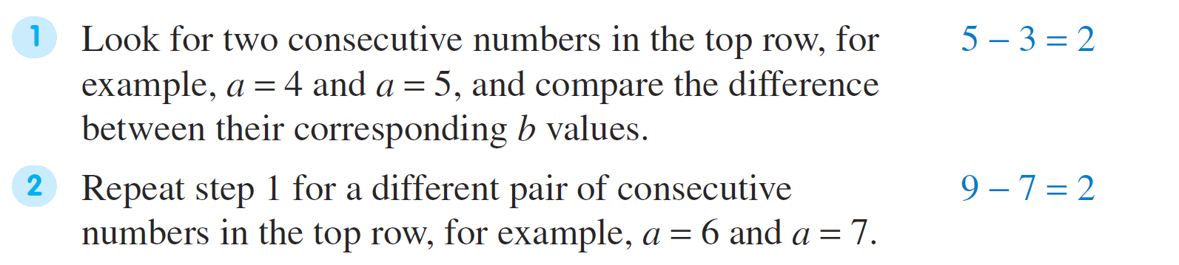
24
7
30
Finding a Formula 2
Date
EQ – How do you find a formula from a table?

Slide 10
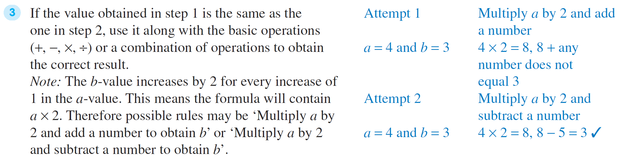
24
7
30
Finding a Formula 2
Date
EQ – How do you find a formula from a table?

Slide 11
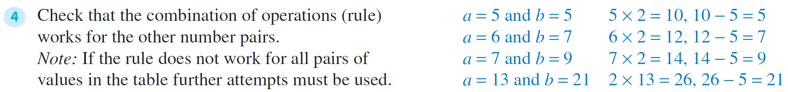
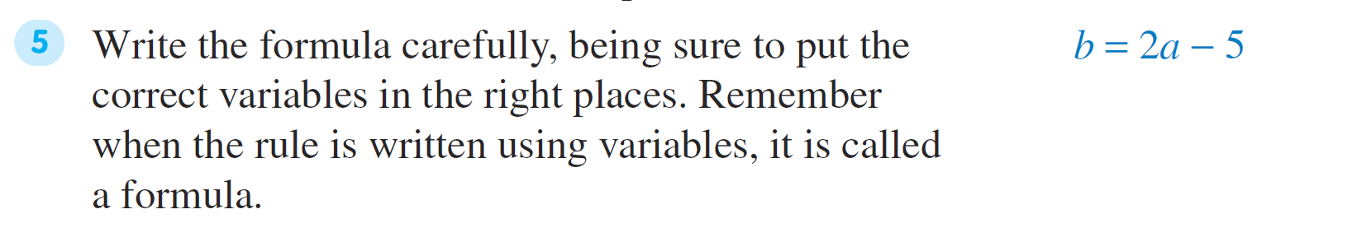
24
7
30
Finding a Formula 2
Date
EQ – How do you find a formula from a table?

Slide 12
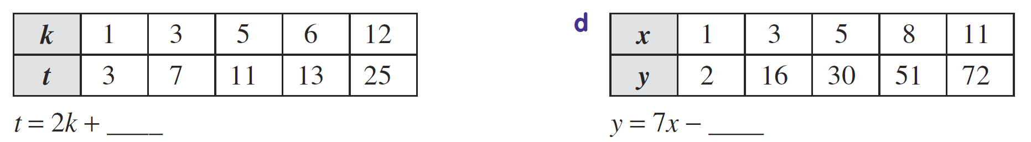
Practice

Slide 13
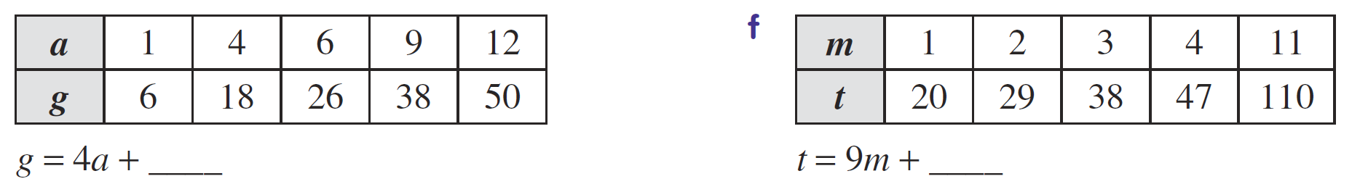
Task

